Slide 1


Buck’s QUEST
THE GAME
PRESENTED BY:
SURESH B.TECH-IT
8TH SEMESTER 63541
Project Guide:
ER. AKSAHY BHARDWAJ
(ASSISTANT PROFESSOR)

Slide 2
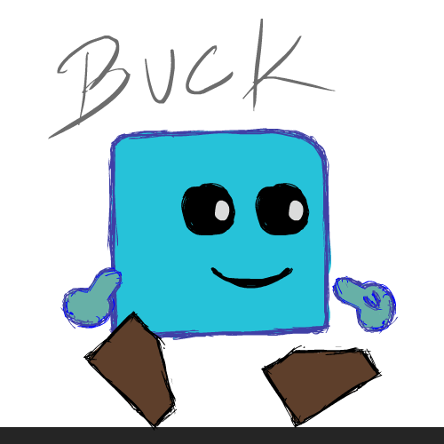
BUCK’S QUEST THE GAME
WE WILL WALK THROUGH
1. INTRODUCTION TO THE GAME
2. PLANNING GAMEPLAY AND LEVEL DESIGN
3. GAME DESIGN DOCUMENT AND
4. DEPLOYMENT

Slide 3
INTRODUCTION

Slide 4
INTRODUCTION
Buck’s Quest is a 2D game created in Unity Game Engine.
It is puzzle platform game like Playdead’s Limbo game and That Level again.
It is created to explore the game development process like, game deign document AKA GDD, game programming, game story development, game deign theory, life cycle of game development.
Video game development and developer.
Game programming.
Artificial Intelligence Computer Simulation
Computer Graphics Physics Engine
Network Programming Database Programming

Slide 5
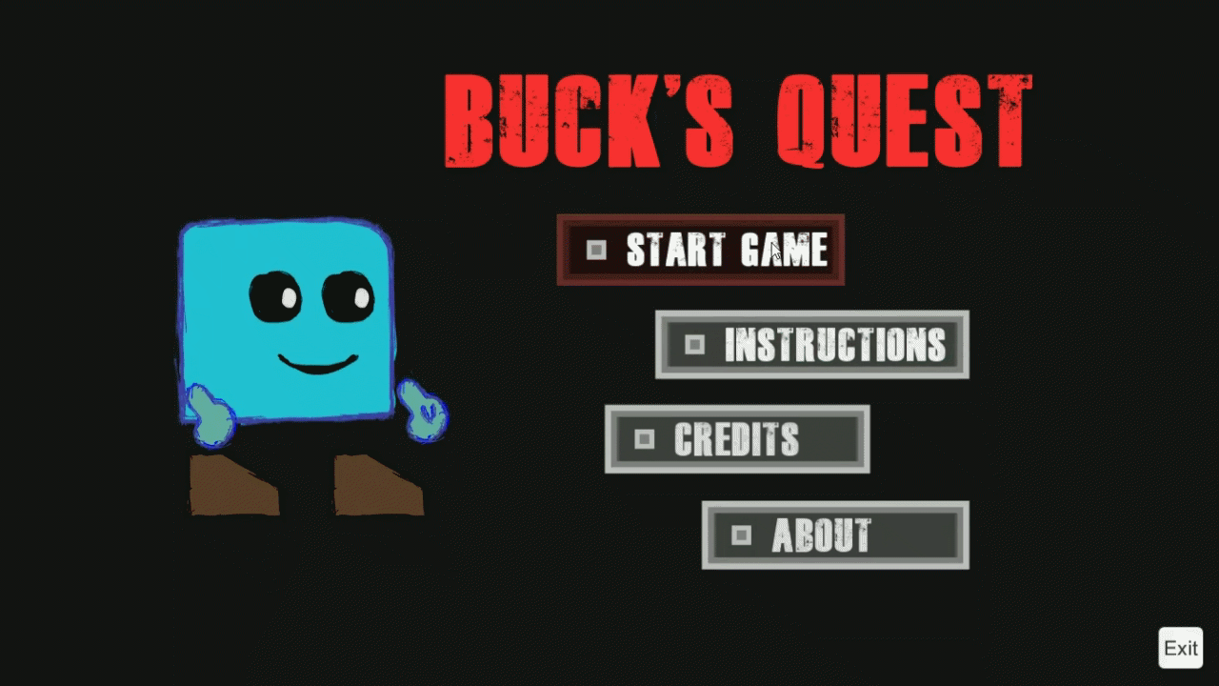
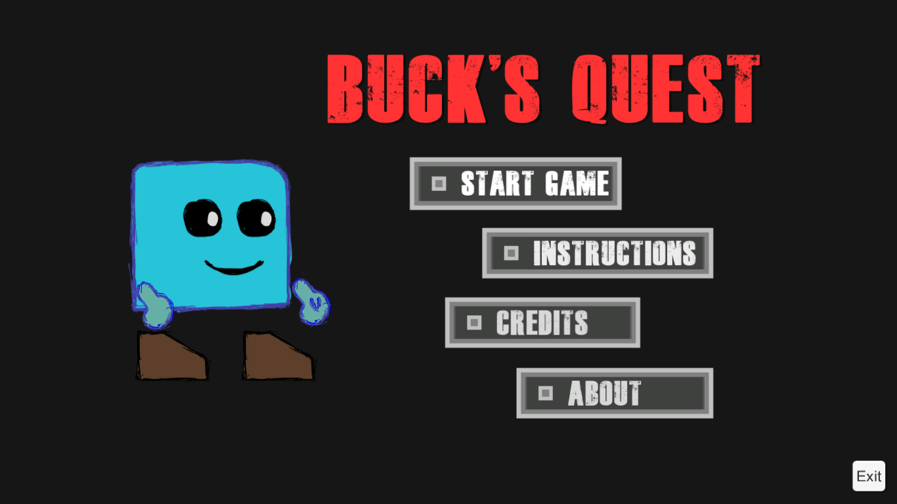


INTRODUCTION (cont..)

Slide 6
PLANNING GAMEPLAY AND LEVEL DESIGN

Slide 7
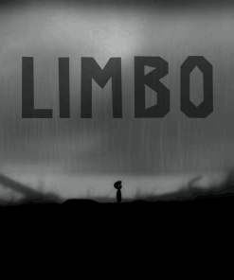
PLANNING GAMEPLAY AND GAME LEVEL DESIGN
I studied various games to come up with game idea like Playdead’s limbo, Inside and “that level again”.
Setting up the constraint to develop the ideas: -
2d game.
Trivial locomotion.
Straight Story and Play.
Sticking to one genre, here puzzle.

Slide 8
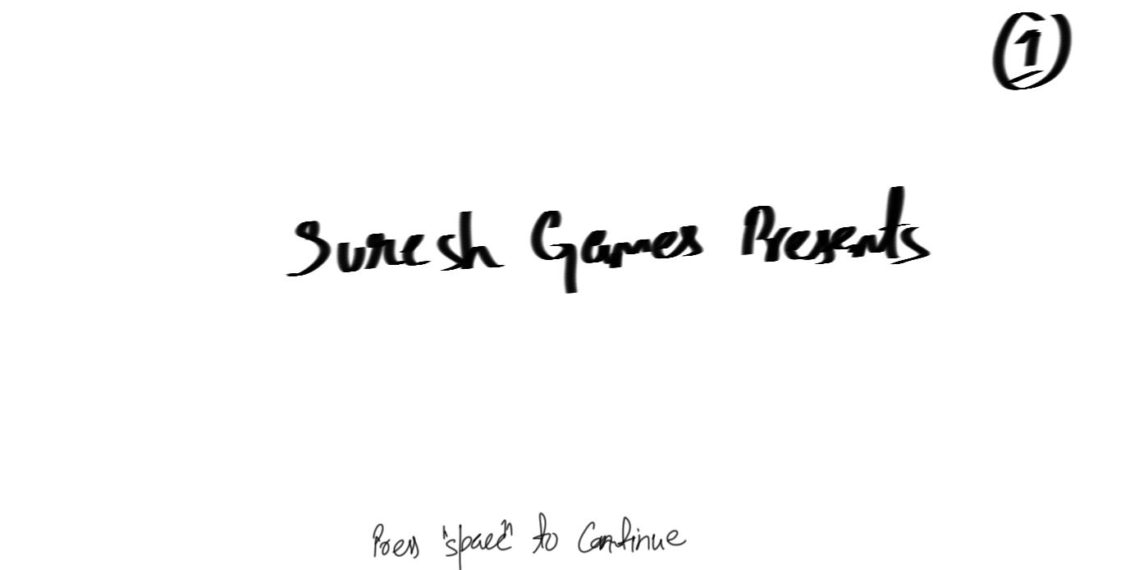

PLANNING THE GAMEPLAY AND LEVEL DESIGN
Welcome screen
AKA Splash Screen:

Slide 9
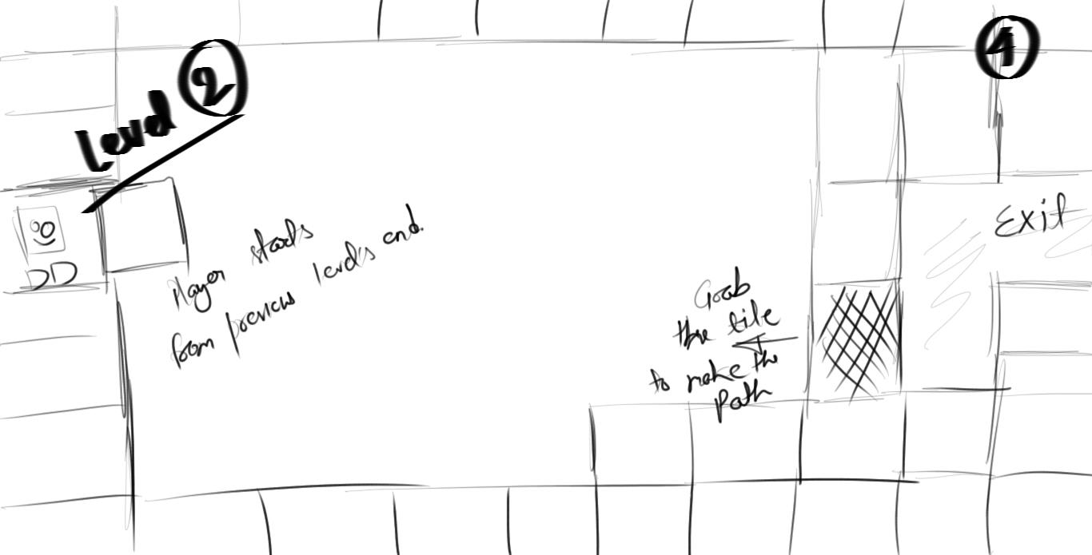
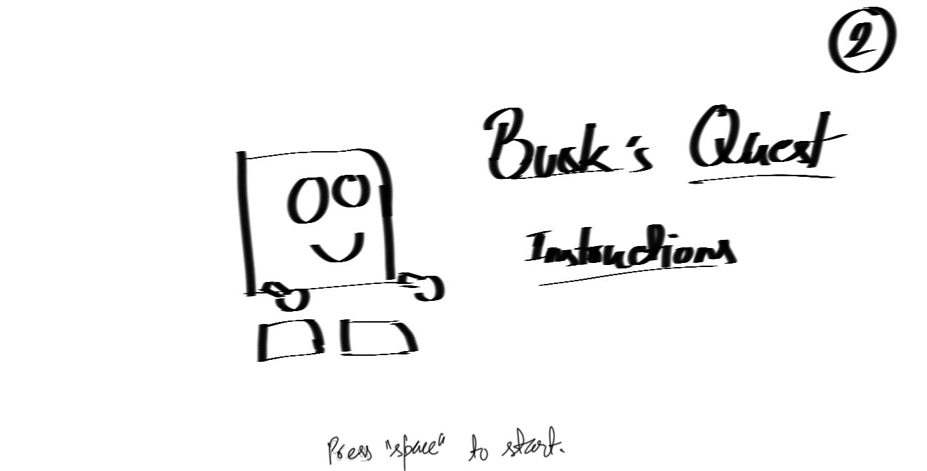
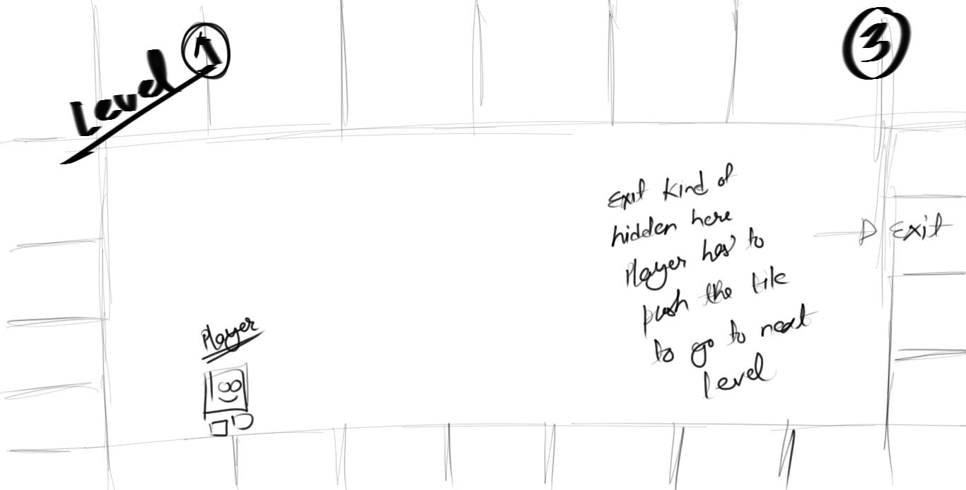
PLANNING THE GAMEPLAY AND LEVEL DESIGN (cont..)
Abstract of Level Deign and Gameplay Plans:

Slide 10
GDD

Slide 11
GDD (GAME DESIGN DOCUMENT)
It is the Blue-print for game development
Designed by Game Designer very similar to a Film Director.
It is highly descriptive living document for video game development.
It is contained of following type of structure:
1. Deigning the Play 2. Creating the Prototype
3. Theme/Genre 4. Game Mechanics
5. Project Scope 6. Assets Development
7. Programming 8. Deployment

Slide 12
PROTOTYPING, THEME AND GENRE
MODULES
PROTOTYPE IS EARLY SAMPLE OF SOFTWARE TO TEST OUT THE NECESSARY CASES AND SUCCES RATE OF THE CURRENT PLAY.
A prototype is generally used to evaluate a new design to enhance precision by system analysts and users.
Puzzle video games make up a unique genre of video games that emphasize puzzle solving.

Slide 13



ANIMATIONS
User/Customer login

Slide 14
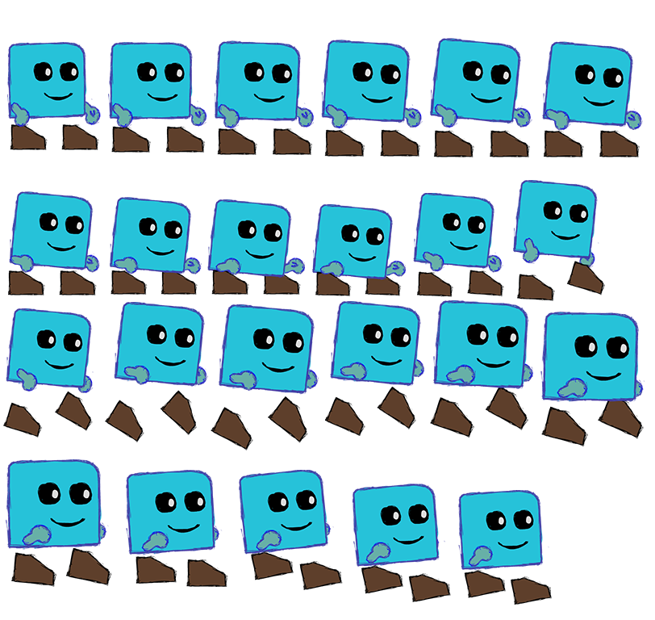

SPRITES AND TEXTURES
User/Customer login

Slide 15
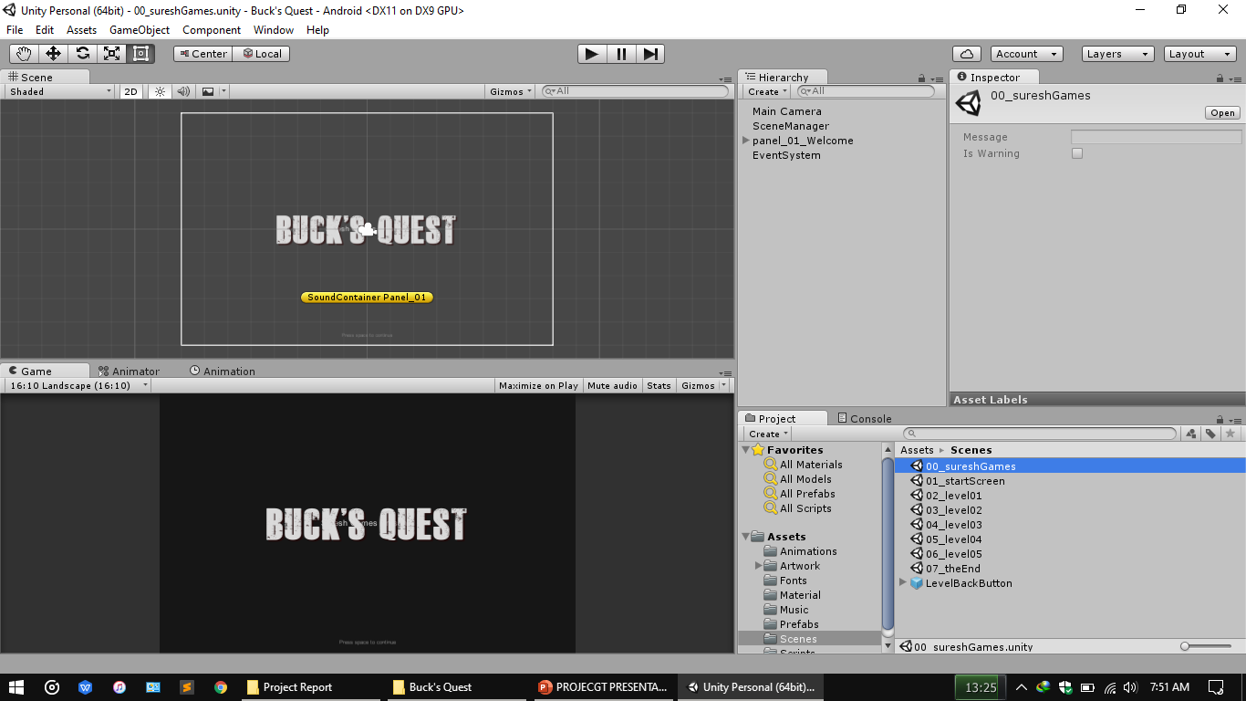
SCREENSHOTS SHOWING GAME DEVELOPMENT
Driver

Slide 16
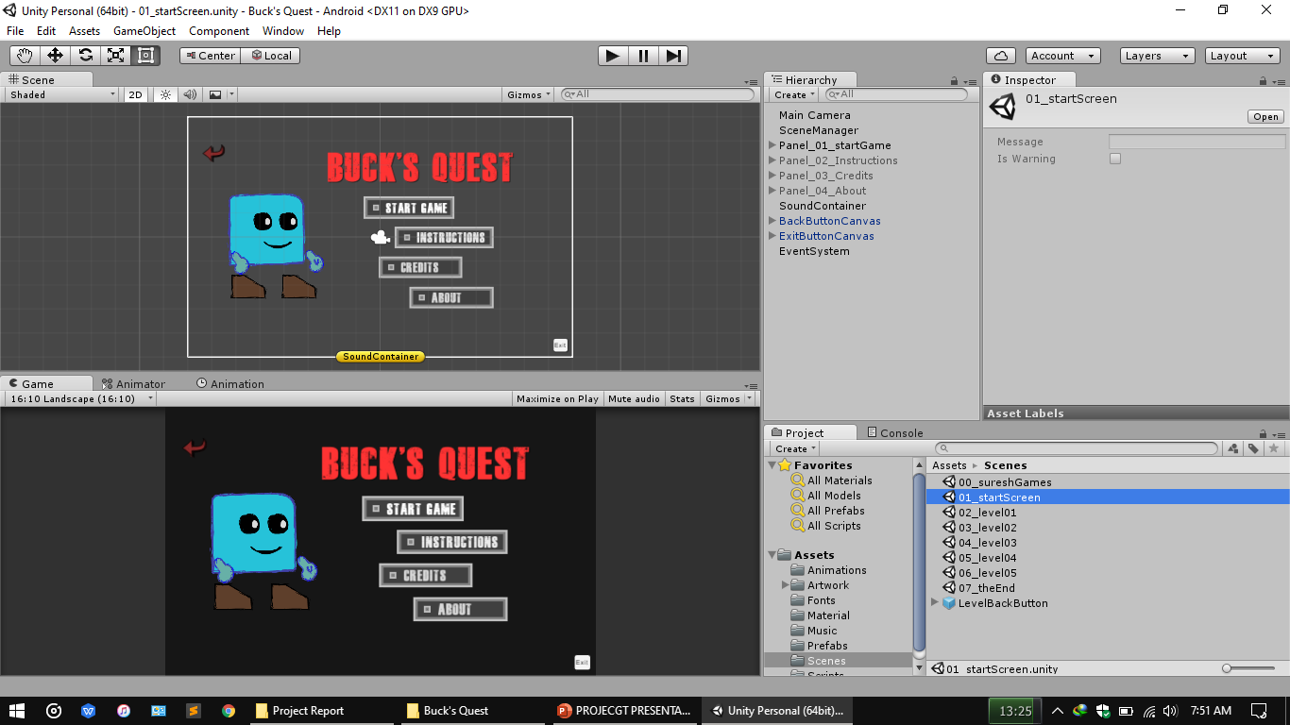
SCREENSHOTS SHOWING GAME DEVELOPMENT

Slide 17
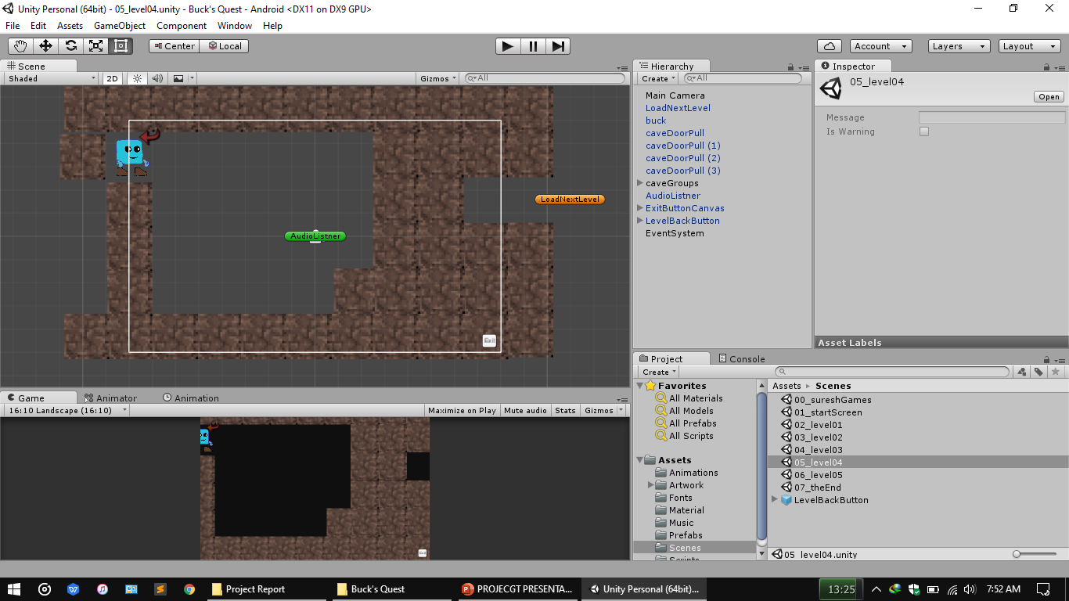
SCREENSHOTS SHOWING GAME DEVELOPMENT

Slide 18
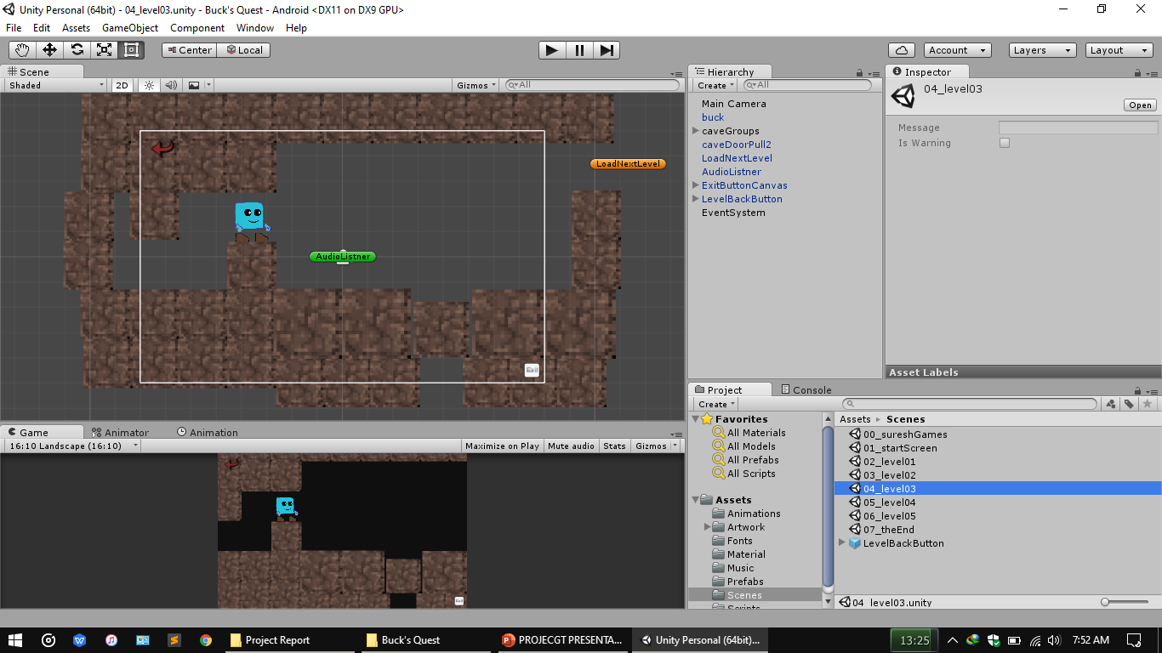
SCREENSHOTS SHOWING GAME DEVELOPMENT

Slide 19
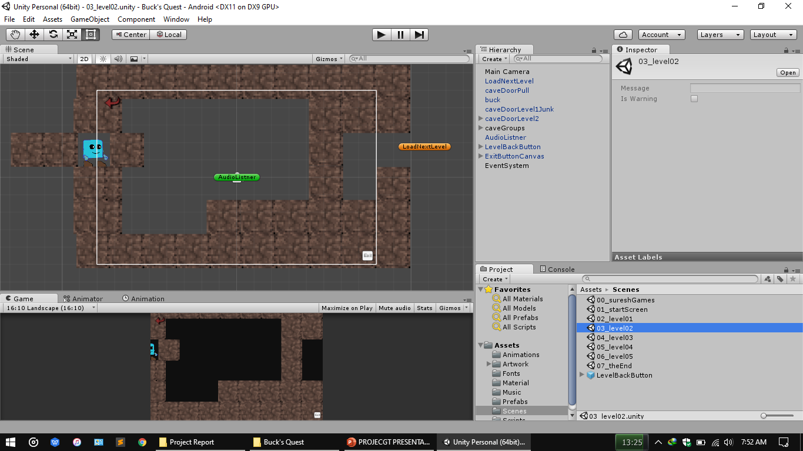
SCREENSHOTS SHOWING GAME DEVELOPMENT

Slide 20
SCREENSHOTS SHOWING GAME DEVELOPMENT

Slide 21
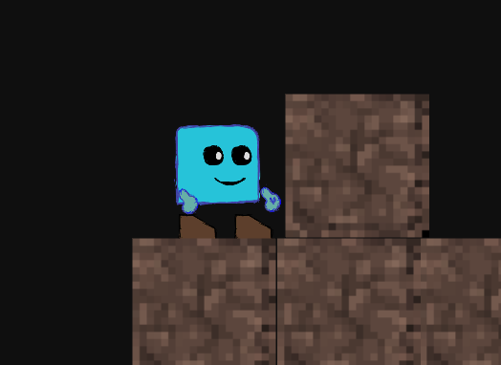
PROGRAMMING SCRIPTS
SCRIPTS: - 1. BUCK’S CONTROL
Player Locomotion:
Player walk.
Player Jump.
Player run.

Slide 22
PLAYER WALK CONTROLS
if (Input.GetKey ("right") && !Input.GetKey (KeyCode.RightControl)) {
speedX = walkSpeed;
render2D.flipX = false;
animator.SetInteger ("AnimState", 1);
} else if (Input.GetKey ("left")&& !Input.GetKey (KeyCode.RightControl)) {
speedX = -walkSpeed;
render2D.flipX = true;
animator.SetInteger ("AnimState", 1);
}else
animator.SetInteger ("AnimState", 0);

Slide 23
LOADING NEXT SCENE
// Update is called once per frame
void Update () {
timer1 += Time.deltaTime;
if (panelWaitTime < timer1 && !lockPanelLoad) {
if (Input.GetKeyDown ("space")) {
panel_01.SetActive (false);
lockPanelLoad = true;
panel_02.SetActive (true);
StartCoroutine ("Timer2");
}
}
if (sceneWaitTime < timer2 && lockPanelLoad) {
if (Input.GetKeyDown ("space") && !loadLock) {
LoadScene ();
}
}
}
IEnumerator Timer2(){
for (;;) {
timer2 += Time.deltaTime;
yield return null;
}
}
void LoadScene(){
loadLock = true;
SceneManager.LoadScene (nextSceneName);
}
}

Slide 24
GRABING THE TILE
using UnityEngine;
using System.Collections;
public class GrabDoor : MonoBehaviour {
public float walkSpeed = 1;
void OnTriggerStay2D(Collider2D target){
if (target.gameObject.tag == "Player") {
if (Input.GetKey (KeyCode.RightControl) && Input.GetKey ("left")) {
this.transform.Translate (-walkSpeed, 0f, 0f, Space.Self);
}
}
}
}

Slide 25
GAME DEPLOYENT

Slide 26
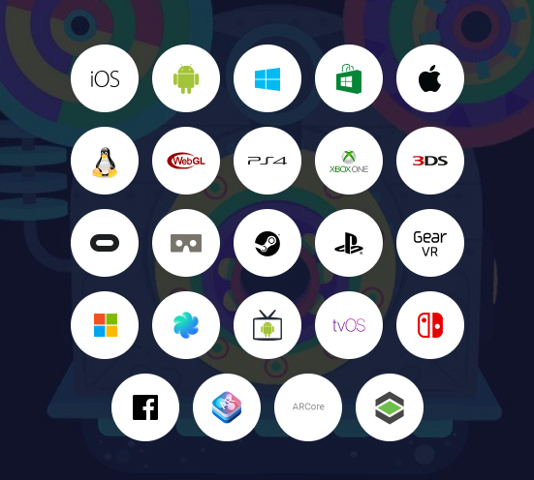
GAME DEPLOYMENT
Platforms: -
1. iOS
2. Android
3. PlayStation
4. Windows Store
5. XBOX
6. Web
7. Linux
8. MacOSX

Slide 27
THANK YOU

